Slide 1
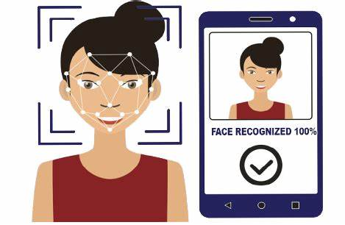
FACE RECOGNITION ATTENDANCE SYSTEM

Slide 2
TEAM SUPERVISOR:
TEAM LEADER:
Dr. Vidushi
Muskan Choudhary
TEAM MEMBERS:
AVNI TYAGI
!

Slide 3
INTRODUCTION
Every College require an attendance system to maintain record of present student.
Face Recognition Attendance System is developed for the Faculty to maintain attendance record.
It uses facial recognition technology to identify the person’s facial features and automatically mark attendance which is very fast enough than previous method.

Slide 4
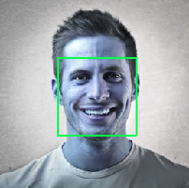
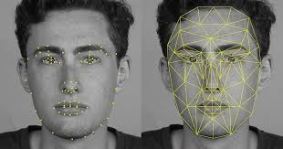


FOUR MAIN COMPONENTS:
POWERPOINT
CANVA
IMAGE PROCESSING
FEATURE EXTRACTION
Matching With Database
Attendance marked

Slide 5
PROCESS:
The First step a webcam window will pop up and will capture the person through Webcam and show the Active status In the Second step the data from database will show up that will tell the total attendance till date, Id of the student, Major, Name, Standing, Starting year, Last Attendance time. In third step attendance will be marked Fourth step is if the student try to get market again within 24 hours then it will show that the student is Already Marked.

Slide 6
SOFTWARE REQUIREMENTS
Python 3 or above
Library - open cv, Dlib, Face_Recognition, cvzone, cmake
Development and compatible tools used - Pycharm, Anaconda

Slide 7
HARDWARE REQUIREMENTS
Central Processing Unit (CPU) - Intel Core i5 6th gen or AMD processor equivalent.
RAM - 8 GB minimum, 16 GB or higher is recommended.
Graphics Processing Unit (GPU) - NVIDIA GeForce GTX960 or higher
Inbuilt Camera or Webcam Support
Operating System (OS) - Ubuntu or Microsoft Windows 10
Storage - 20 GB

Slide 8
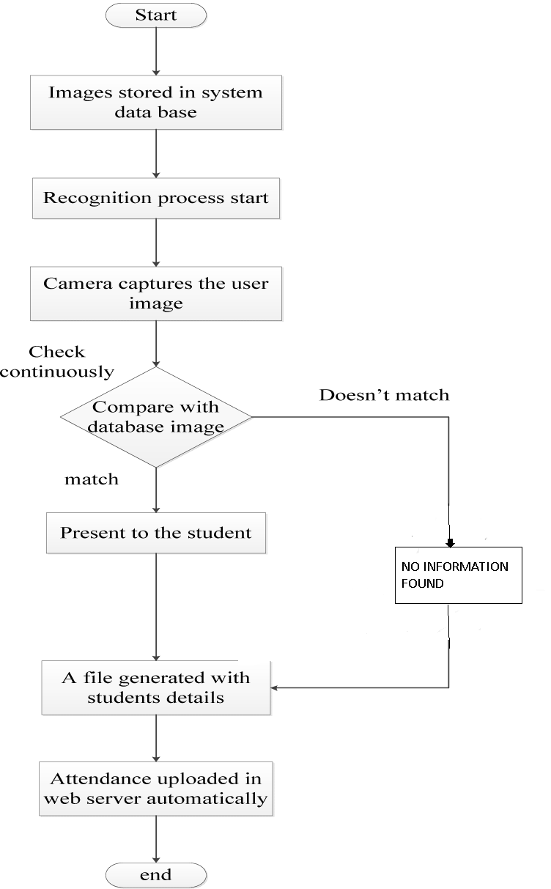
FLOW CHART

Slide 9
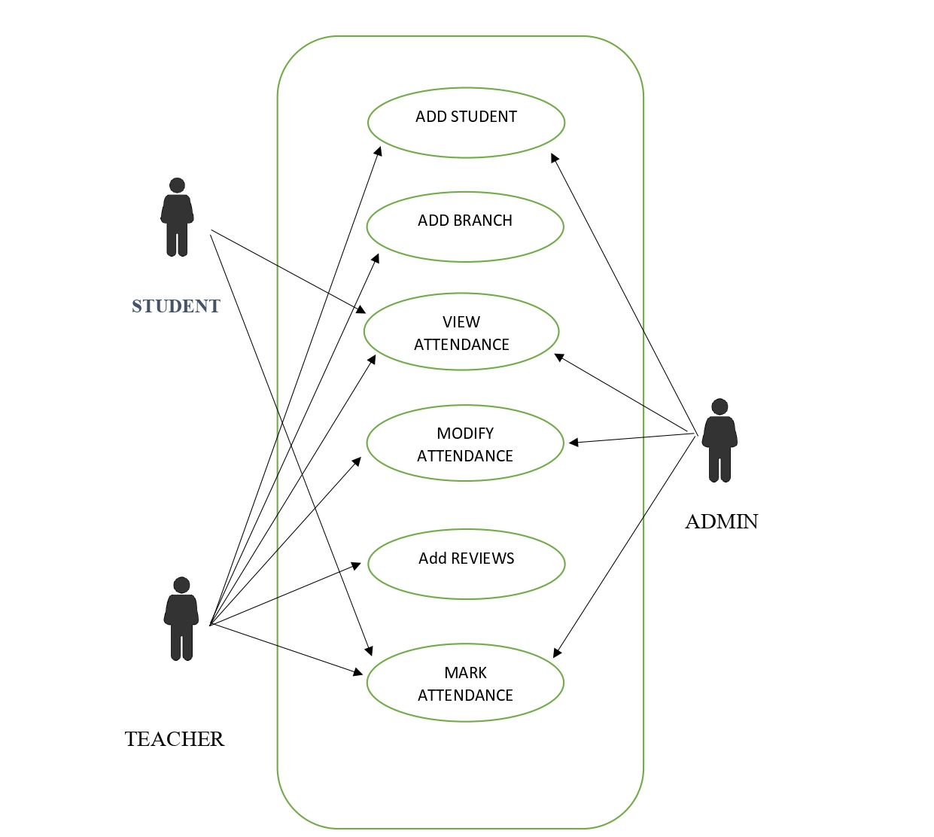
USE CASE DIAGRAM

Slide 10
CONCLUSION:
Before the development of this project.
There are many loopholes in the previous method while taking attendance using old method which caused many troubles to most of the institutions.
Therefore, the facial recognition feature method is secure enough, reliable and available for use.
It saves time and lot of effort, especially if it is a lecture with huge number of students

Slide 11

THANKS FOR
WATCHING

